Slide 1
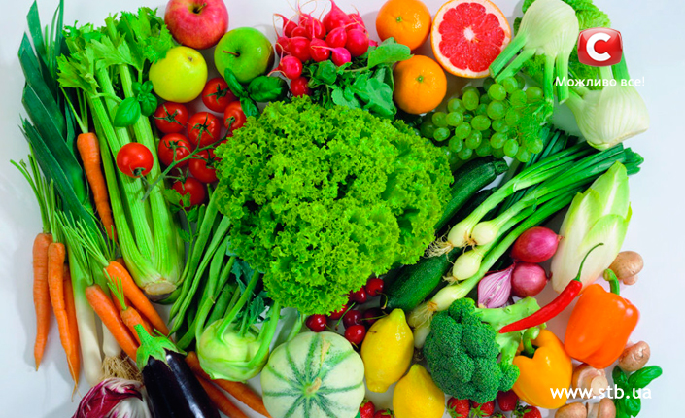
Our handy food and health tips!

Slide 2
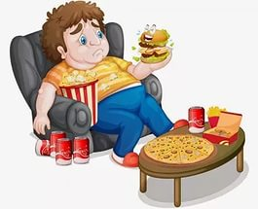
Robin, Robin, what a man!
He eats as much as no one can.
He ate a lot of meat, he ate a lot of fish,
He ate a lot of ice-cream and a sweet.
He ate a lot of porridge and ten eggs
And all the cookies Mother had.
He drank a lot of juice, he ate a cake
Then said: “I have a stomachache”.

Slide 3
Overweight- too fat
Underweight-below the normal weight
Lack of concentration-not enough of concentration
Tiredness-feeling that you want to sleep or rest
Tooth decay-when tooth are slowly destroyed
Frequent illness- being ill very often
Indigestion- pain that you get when your stomach cannot break down food that you have eaten
Dry skin-having no water in skin

Slide 4
problems | solutions
a) overweight | eat less & take regular exercise
b) underweight | eat three well-balanced meals & three or four snacks per day
c) lack on concentration | eat lots of iron- rich foods and have a good breakfast
d) tiredness | follow a low-carbohydrate diet
e) tooth decay | cut out sugary drinks & snacks
f) frequent illness | eat foods rich in vitamin C
g) Indigestion | avoid spicy foods & eating fast or late at night
h) dry skin | drink more water & eat more only fish, nuts & seeds

Slide 5
1 | 2 | 3 | 4 | 5 | 6 | 7 | 8
b | d | g | a | e | h | c | f

Slide 6
Advising | Responding
• Have you thought about/What about…(+verb+ing)? • It would be best if you (+ past simple) • You might feel better if… • (Don`t you think) you ought to/should…? • You`d better.. • It might be a good idea to • Why don`t you?... • If I were you, I`d… | Agreeing • That`s not a bad idea. • Thanks, I hadn`t thought of that. I`ll try it! • That` a great idea. Disagreeing • Maybe you`re right/it`s a nice idea, but… • I`m not so sure/I`m not sure if it`ll work. • I`ve already tried that and it didn`t work.

Slide 7
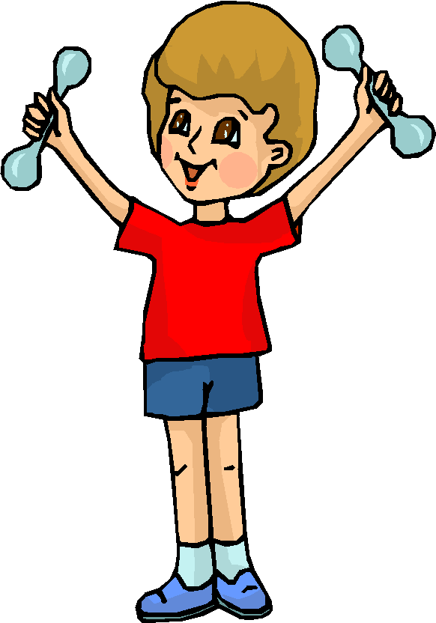
I put my hands upon my hips,
I turn myself around.
I raise my hands above my head
And then I touch the ground.
My hands upon my head I place,
On my shoulders, on my face.
Then I raise them up on high
And make my fingers quickly fly
Then I put them in front of me
And gently clap: one, two, three.

Slide 8
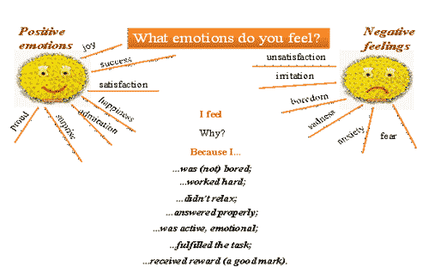
What do you feel?

Slide 9
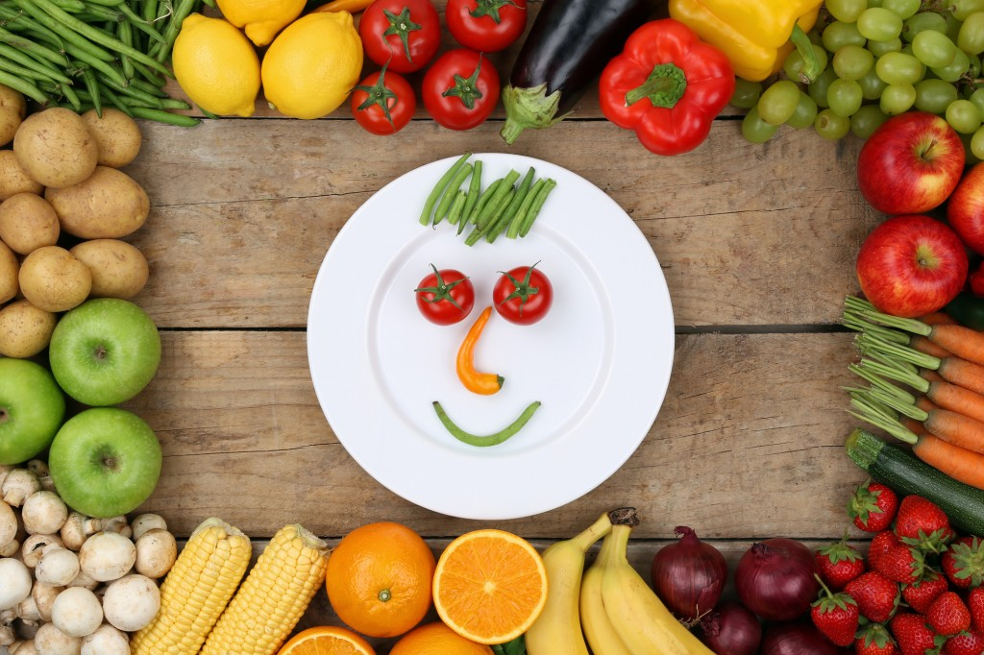
GOOD LUCK!

